Slide 1
Airline Reservation
Team Members:
1. PRIYAL MEHTA (TL)
2. JANHAVI DESHPANDE
3. EKTA SINGH
4. SOUVIK BASU

Slide 2
Acknowledgement
We extend our sincere gratitude towards LTI Pvt Ltd for providing us this opportunity .
Special thanks to Mr. Dibakar Sanyal and Mr. Majrul Ansari for training us and guiding us through our project gladiator phase by providing their undivided attention .
We would also like to take this opportunity to thank Mr. Dinesh Malwade , Mr. Santosh Pande and Mr. Nikhil Govekar for their individual help provided in order to help us complete the project .

Slide 3
Problem Statement
Today’s most of the airline website are lagging in some areas like some are not providing proper UI which could be user friendly while some are slow in processing pages or are not dynamic.
Software must be developed for automating the online reservation system of airline.
A system should be designed to provide functionalities like booking of tickets and cancellation in which a user should be able to apply and cancel for tickets of a flight very easily.

Slide 4
Technologies Used
HTML
CSS
JavaScript
JSP
Hibernate
Spring MVC
Oracle

Slide 5
Tools used
VS Code
Eclipse IDE
SQL developer
TOMCAT server

Slide 6
Flow Chart
User
Search flights
Admin Login
no
Flight
exists?
Add flight
Add route
View Users
View flights
Delete flights
yes
Login/Register
Book Flight
Admin Logout
Payment
Cancel

Slide 7
Mandatory Modules
Flight Search
Registration
Login
Payment
Cancellation

Slide 8
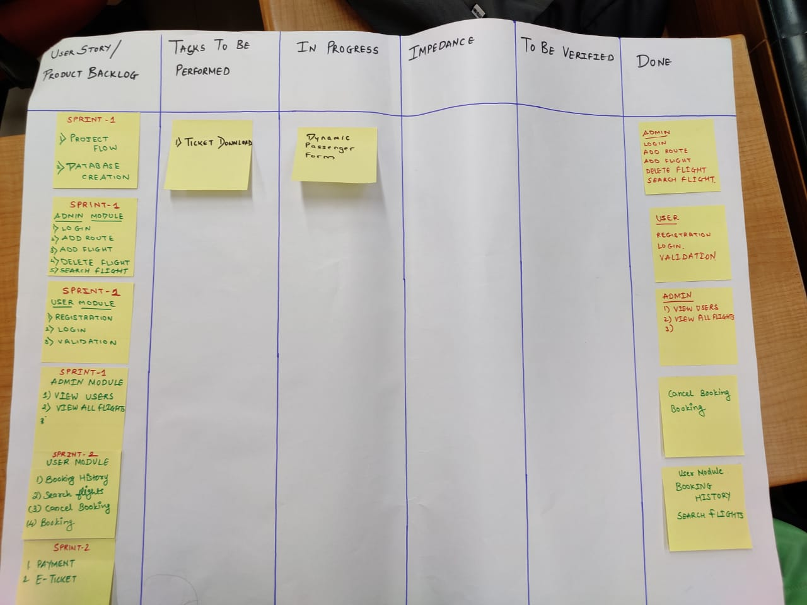
Scrum Board

Slide 9
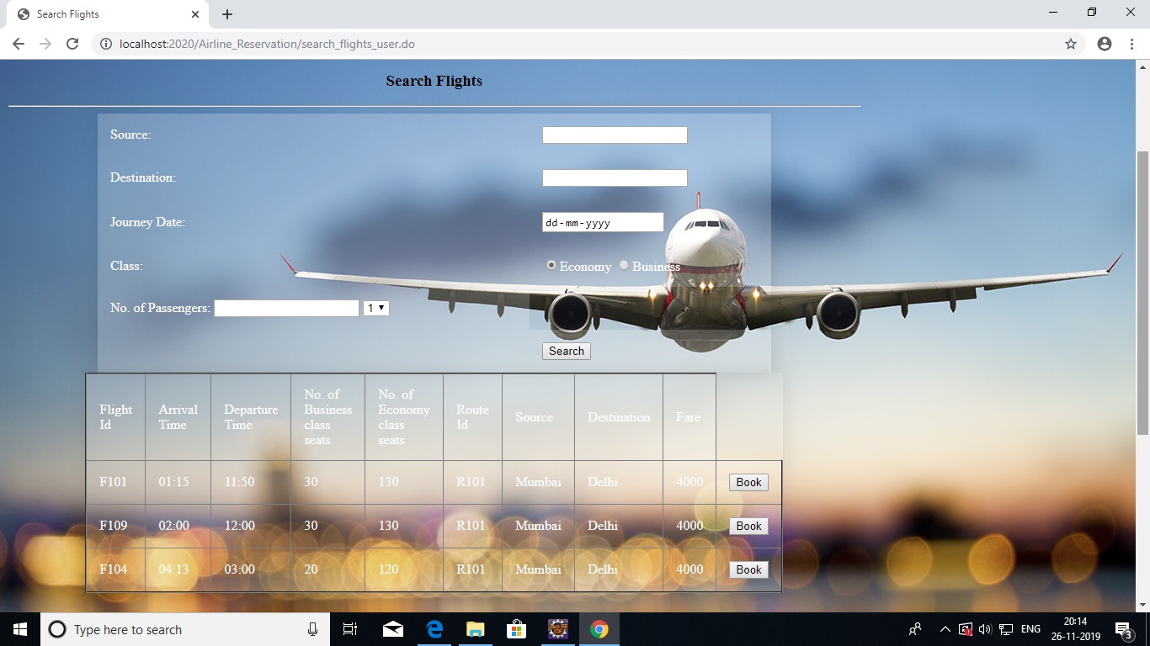
Search Flights

Slide 10
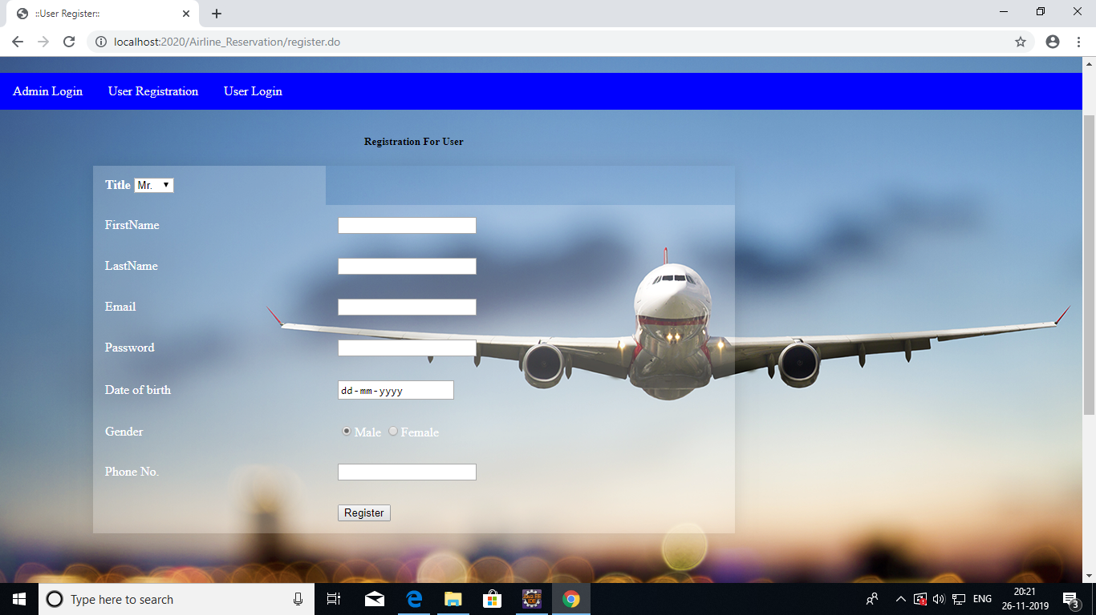
Registration

Slide 11
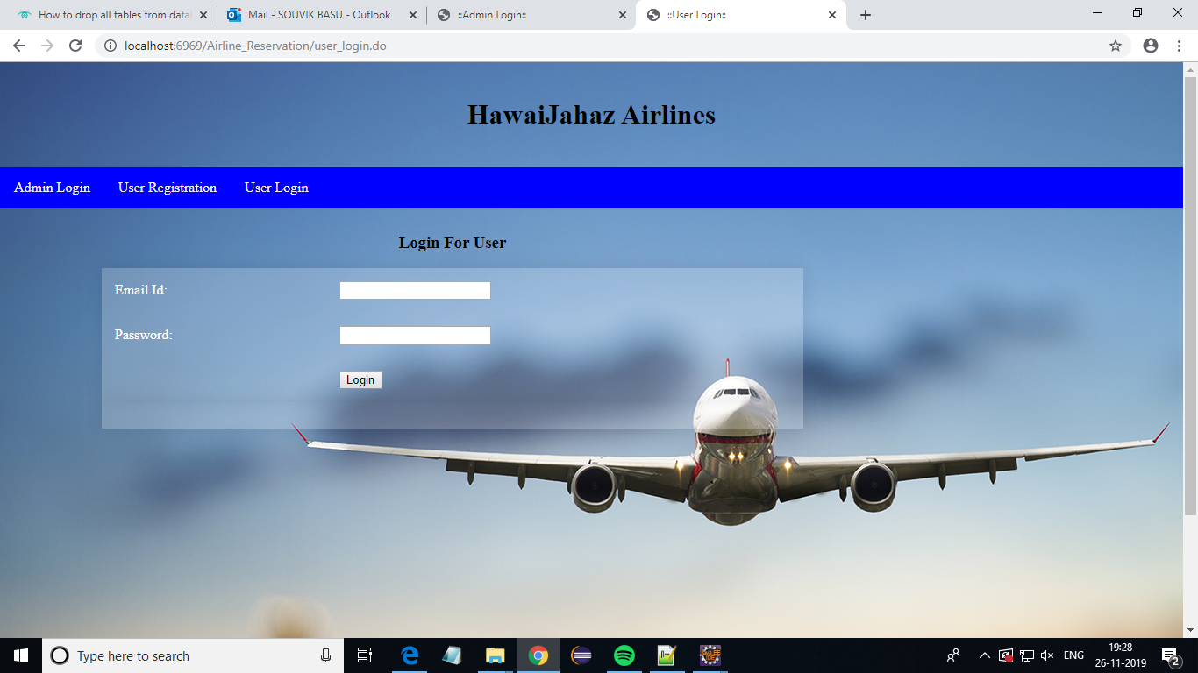
Login

Slide 12
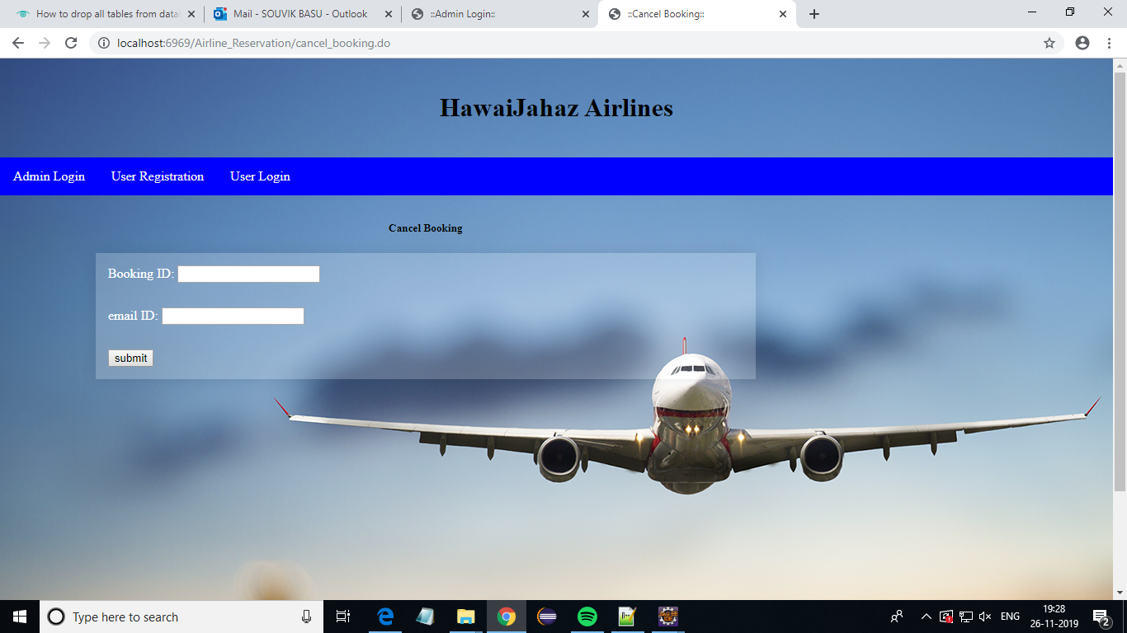
Cancellation

Slide 13
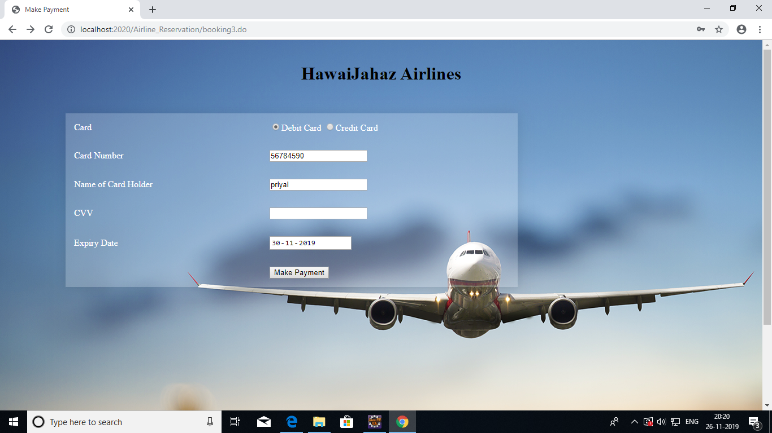
Payment

Slide 14
Thank You!

